Slide 1
Microsoft: Our Mission, Strategy & Culture

Slide 2
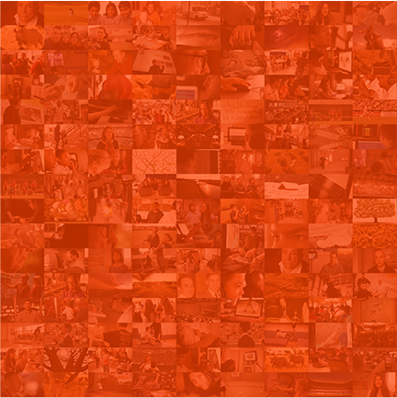

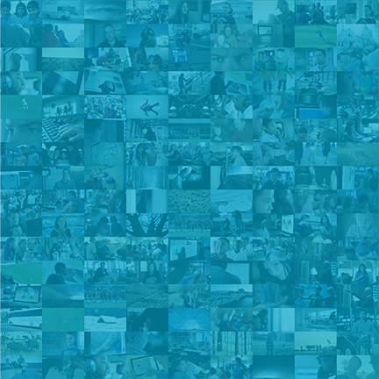


Microsoft
Our
mission
Empower every person and every organization on the planet to achieve more
Notes:
Every great company has an enduring mission. We’ve challenged ourselves to think about our core mission, our soul – what would be lost if we disappeared.
We will empower every person and every organization on the planet to achieve more.
We have unique capability in harmonizing the needs of both individuals and organizations. This is in our DNA.
Perhaps “on the planet” is the most important and interesting idea in that statement. We care deeply about taking things global and making a difference in lives and organizations in all corners of the planet.
Again, doing so isn’t simply good business. It’s playing a small part in the most fundamental of human activities: creating tools that enable each of us to continue our journey to become something more.

Slide 3




Our
mission
worldview
Mobile-first
Empower every person and every organization on the planet to achieve more
Cloud-first
Notes:
Our mission is grounded in both the world in which we live and the future we strive to create. Today, we live in a mobile-first, cloud-first world, and the transformation we are driving across our businesses is designed to enable Microsoft and our customers to thrive in this world. It’s important to note that our worldview for mobile-first is not just about the mobility of devices; it’s centered on the mobility of experiences that, in turn, are orchestrated by the cloud. That is why we think of these two trends together. What we do with our products and business models has to account for this fundamental transformation.
When we say mobility or mobile-first, the key thing is to remember that this is not the mobility of the device, it's the mobility of the human experience.
There are going to be no digital boundaries at all with the computing fabric that surrounds you. So that's what we think of when we say "mobile first."
And these experiences are, in turn, orchestrated by the cloud. It’s the experiences that surround you in your daily life, at home, or at work. All of your devices and services need to work in a friction-free way, supported by the cloud and new form factors.

Slide 4
Reinvent productivity & business processes
Create more personal computing
Build the intelligent cloud platform
Notes:
So we have a clear mission. It’s a simple idea really. Even though it’s pretty audacious.
Empowering everyone on the planet. To achieve more.
Not just individuals. Not just organizations. Everyone.
And we’ve set out to empower them to do, and more importantly, accomplish, an amazingly wide assortment of things.
We’re not going to be content to simply automate a handful of common tasks.
Instead we’ve set our sights on providing better tools for empowering the diverse world of activities make humans so distinctly powerful.
We are the only company that thinks about all these things in an expansive way.
It drives us to identify and eliminate the barriers that prevent people from being empowered in any situation they find themselves in throughout their personal and professional lives.
And so we ask ourselves a simple question: What stops people from achieving more? Not simply doing more, but becoming more.
We think it comes down to 3 things: They need help overcoming the limits of time, place, and complexity.
To that end, there are three interconnected areas where our customers expect us to lead and innovate…
Reinvent productivity and business processes
Build the intelligent cloud platform
Create more personal computing
These ambitions utilize a unique set of assets that span productivity services, cloud platform, our device platform and our family of devices. There is an explicit path dependence on how we achieve the “inter-connectedness” between the various elements of our strategy to gain momentum.

Slide 5

Communications
Reinvent productivity & business processes
Meetings & collaboration
Loved for work & life
Built for teams & networks
Personal & org insights
People-centric security
Content creation
File share & content management
Business apps
Notes:
People, at work or at home, in teams or alone, need to make the most of their time.
Since people, and what they can produce together, are the engine of human progress, their ability to be productive is, in many ways, a governor on what we can achieve as a species.
So, we are reinventing the services that people use to be productive.
We will continue to extend and enhance these services to fit into the changing, real-world business processes that reflect how people work today -- as dynamic teams and groups working toward a shared outcome, with the need to collaborate and stay always connected securely, on every device.
And, in a world that generates more information than it can consume, people need help focusing, so they can turn noise into signal and infinite information becomes actionable insight.
These services will have broad appeal and wide use, because they are designed to make anyone productive, together.
In a world where time is most finite, our services will help people live a more productive life, so they can achieve more.

Slide 6
Cloud infrastructure
Build the intelligent cloud platform
Enterprise mobility
Hyper-scale, hybrid, enterprise proven
Open & flexible
Developer & IT productivity
Data to action
Platform for SaaS extensibility
Trustworthy
Data & analytics
Developer & app platform
Internet of things
Notes:
We also live in a world in motion. Our ability to thrive in a mobile world requires a pervasive source of up to date information that moves at the speed of life.
The cloud is where our truth lives, so our second ambition is that the services we just talked about will be powered by an intelligent cloud platform.
And this intelligent cloud won’t just power our services, it will be available on tap to our customers, whether they go all in, or go hybrid.
We built it to help businesses be more responsive and competitive – whether you’re an enterprise building your own customer-facing app or a developer building a commercial SaaS offering.
When data and computing power are available on demand, developers and businesses can extend them to fit their unique needs without having to worry about basics like identity & data management, alongside higher level services like machine learning and analytics.
The ubiquity, power, and flexibility of a cloud that is literally everywhere you need it to be and intelligent enough to adapt to your needs will make limits imposed by location and physics a thing of the past

Slide 7
Universal platform & store
Create more personal computing
Windows as a service
Built for natural interactions
Mobility of experience
Trust with your data
Loved by consumers & IT
Innovative hardware
Engaging experiences
Notes:
Finally, we will overcome the limits in ourselves. As technology has given us ever-increasing capability, it has often come with a companion of equally increased complexity. Our ability to put this power to use is limited by our ability to use it and our willingness to trust it. With Windows we are building a device platform that delights people at work, at play, and beyond – by radically simplifying the way we interact with it.
With breakthroughs in interactions through gesture, gaze, voice, and pen we will make computing so natural, personal, and predictive that it no longer feels like “computing” at all.
As we all use a wider variety of devices, we risk creating islands of data and isolated experiences. So we’re focused on the wider “mobile experience” through universal apps that maintain continuity throughout your day.
When devices have access to more of your data, they can do amazing things, but they must earn the right to do this by being as trustworthy as they are powerful.
So we are committed to making technology that conforms to the needs and preferences of the individuals that use it, not the other way around.
With Windows we will banish complexity – with a universal platform that powers innovative hardware and engaging experiences to make computing more personal.
That’s our story. Now as I said up front, the narrator is an important part of the story. And we’ve rediscovered our “Rebel” side as we’ve emerged from our “Imperial” era. I’d like to dig a little deeper into our culture, and how we are transforming that as well.

Slide 8



Mission
Empower every person and every organization on the planet to achieve more
Mobile-first
Worldview
Cloud-first
Strategy
Build best-in-class platforms and productivity services for a mobile-first, cloud-first world
Reinvent productivity & business processes
Ambitions
Build the intelligent cloud platform
Create more personal computing

